Slide 1
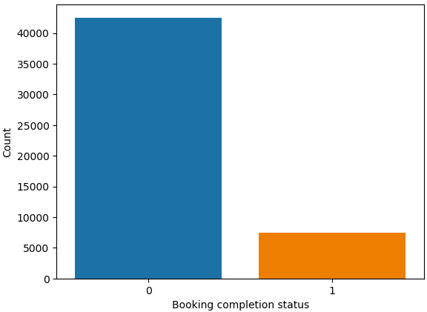
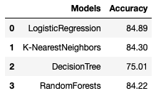
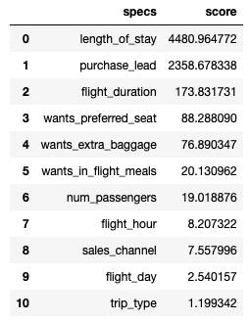
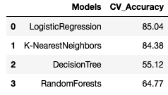
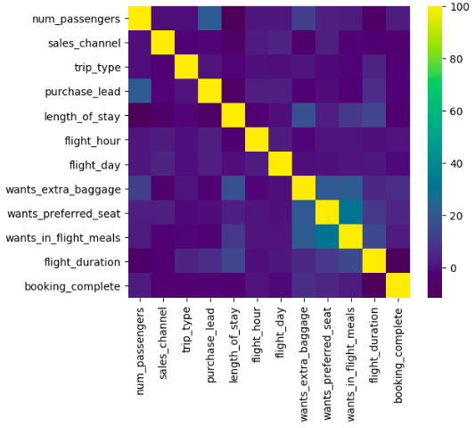
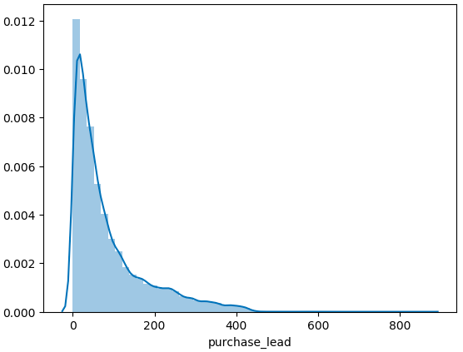
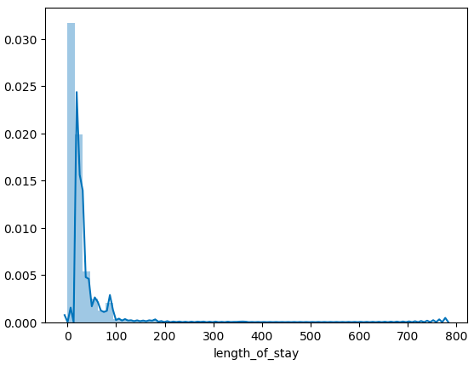
Results from Prediction Models on Customer Buying Behaviour
90% of bookings incomplete
Logistic Regression achieves highest accuracy.
Cross-validation technique also shows Logistic Regression have best accuracy at 85.04%.
‘length_of_stay’ and ‘purchase_lead’ show strong correlation with target variable.

